Slide 1


Fake News Detection using Machine Learning (Veritas AI)
Addressing Misinformation During Critical Events like COVID-19

Slide 2
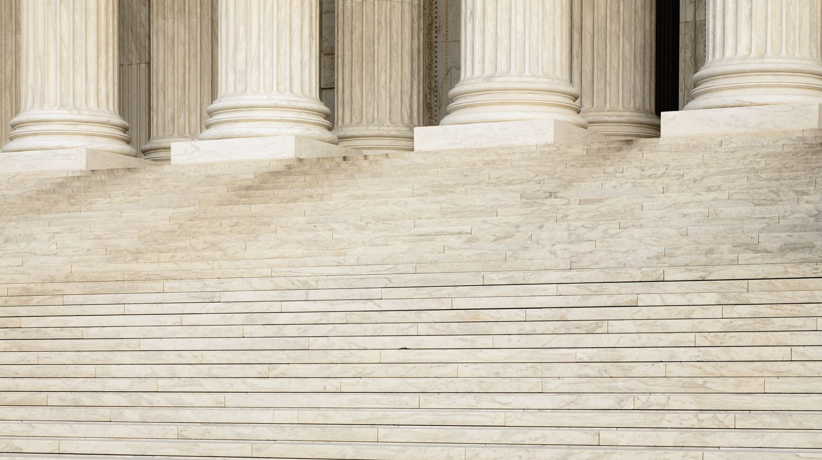
Veritas nonquam perit truth nevers dies

Slide 3

Background
Digital Age Impact: Rapid information spread via social media.
Fake News: False or misleading information with various motives.
Impact Areas: Public safety, politics, health (e.g., COVID-19).
Then the Need for Reliable systems for detecting fake news became very important

Slide 4
Problem Statement
Issue: High prevalence of fake news, particularly during crises.
Challenge: Existing models like CNN and LSTM face limitations.
Objective: Develop a system to quickly detect and prevent misinformation using BERT and RoBERTa.

Slide 5
But how do we know whether a claim is fake or not ?
Credibility
Prior Knowledge
Pattern recognition

Slide 6
Project Objectives
Train a model that identifies the patterns in both fake and real news to be able to predict whether a claim is fake or real based on these identified patterns.

Slide 7
Methodology Overview
Data Collection
Data Preparation
Data Merging
Vectorization
Modeling
Evaluation
Deployment

Slide 8
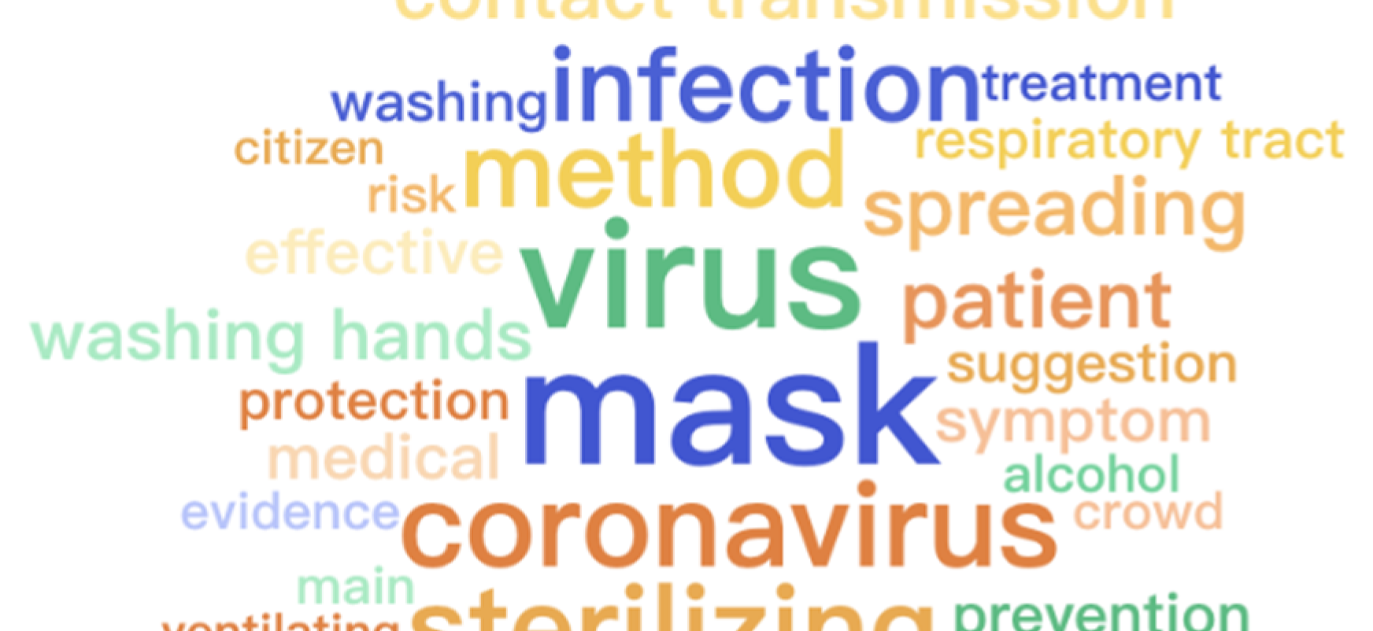

Data Collection
Sources:
PolitiFact: Web scraping for COVID-19 news.
Fighting an Infodemic Dataset: 10,700 annotated social media posts/articles.
This Photo by Unknown Author is licensed under CC BY-ND

Slide 9
Data Preparation
Data cleaning :Remove HTML, punctuation, special characters, URLs, hashtags.
01
Perform lemmatization.
02
Exploratory Data Analysis (EDA):Analyze dataset for trends and characteristics.
03

Slide 10
Data Merging
Objective: Create a comprehensive dataset for modeling.
Action: Combine web-scraped data with Fighting an Infodemic dataset.

Slide 11
Vectorization Techniques
TF-IDF measures word importance in documents
Word2Vec: Vector representation based on word similarity.
End-to-End CNN Embeddings: CNN-based embeddings.
BERT Embeddings: Contextual embeddings from BERT.

Slide 12
Modeling & evaluation
Develop and Train Models:
Machine Learning
CNN (End-to-End Embeddings, Word2Vec) with accuracy of 91%
LSTM with accuracy close to 88%
BERT with accuracy 94%
RoBERTa with accuracy 95%
Fine-Tuning: Optimize model performance.

Slide 13
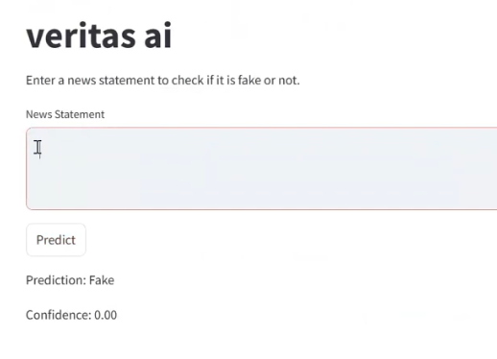
Deployment
Tool: Streamlit
Objective: Create a user-friendly interface for real-time detection.

Slide 14
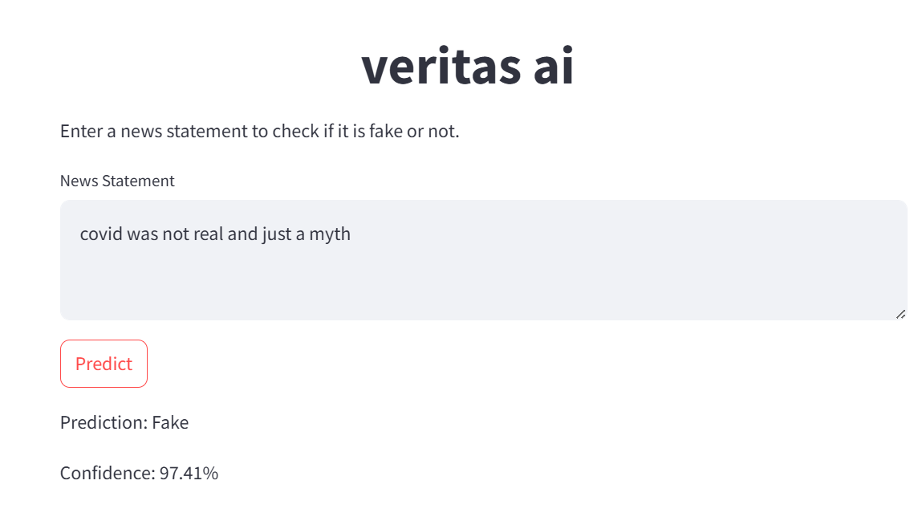

Slide 15
Data Collection
Sources:
PolitiFact: Web scraping for COVID-19 news.
Fighting an Infodemic Dataset: 10,700 annotated social media posts/articles.
This Photo by Unknown Author is licensed under CC BY-ND

Slide 16
Web scraping
Why politifact ?
Importance of data quality
But 1561 row are not enough !

Slide 17
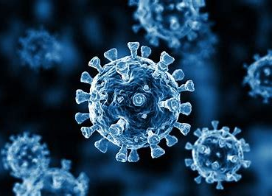
Fighting an Infodemic Dataset
The "Fighting an Infodemic: COVID-19 Fake News Dataset" is a curated collection of data designed to address the spread of misinformation related to the COVID-19 pandemic. It includes various news articles and social media posts labeled as true or false, providing a valuable resource for developing and evaluating fake news detection models.

Slide 18
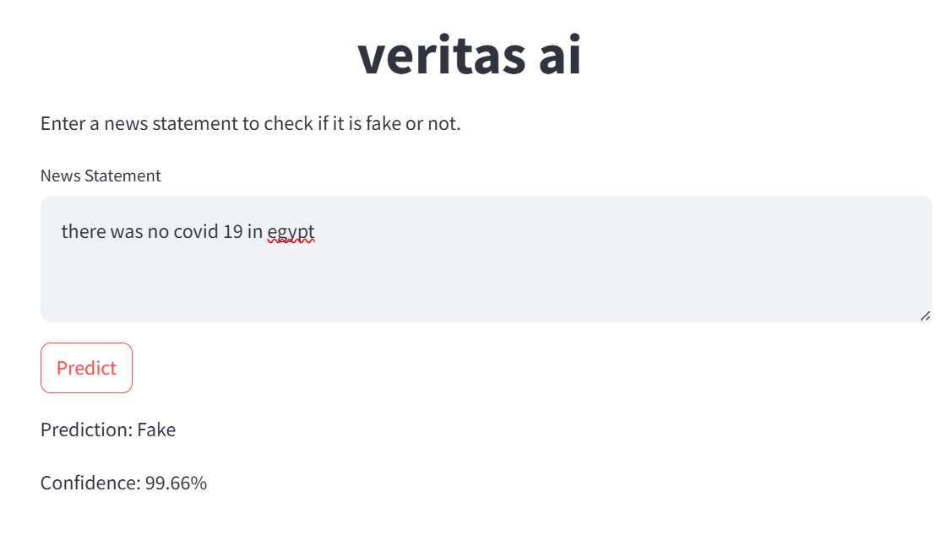

Slide 19
Data Preparation
Data cleaning :Remove HTML, punctuation, special characters, URLs, hashtags.
01
Perform lemmatization.
02
Exploratory Data Analysis (EDA):Analyze dataset for trends and characteristics.
03

Slide 20
Data cleaning
before cleaning
More than 160 potential vaccines for COVID-19 under study. https://t.co/YLCVlZbxSv via @webmd https://t.co/vst2mpeLUq
After cleaning
More than 160 potential vaccines for COVID19 under study

Slide 21
Data cleaning
We used functions to remove:
Stopwords
Urls
Punctuation
Html parser
Special characters
Hashtags and emojis

Slide 22
Data cleaning
We also used functions to :
Lemmatize data
As : Playing play
lowercase

Slide 23
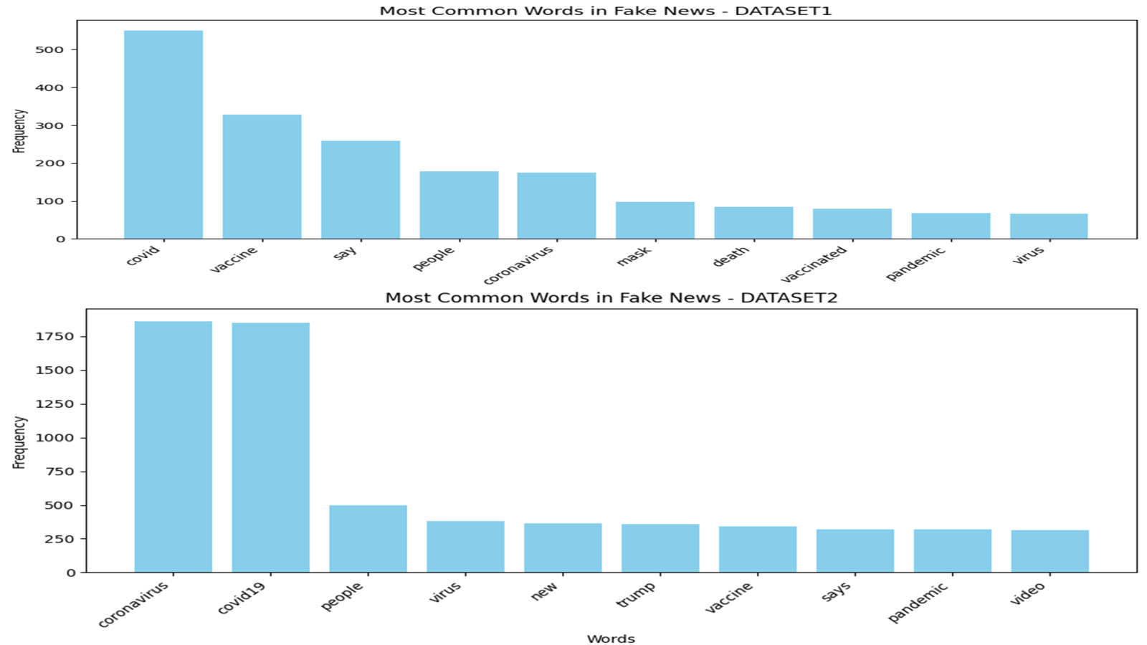
EDA

Slide 24
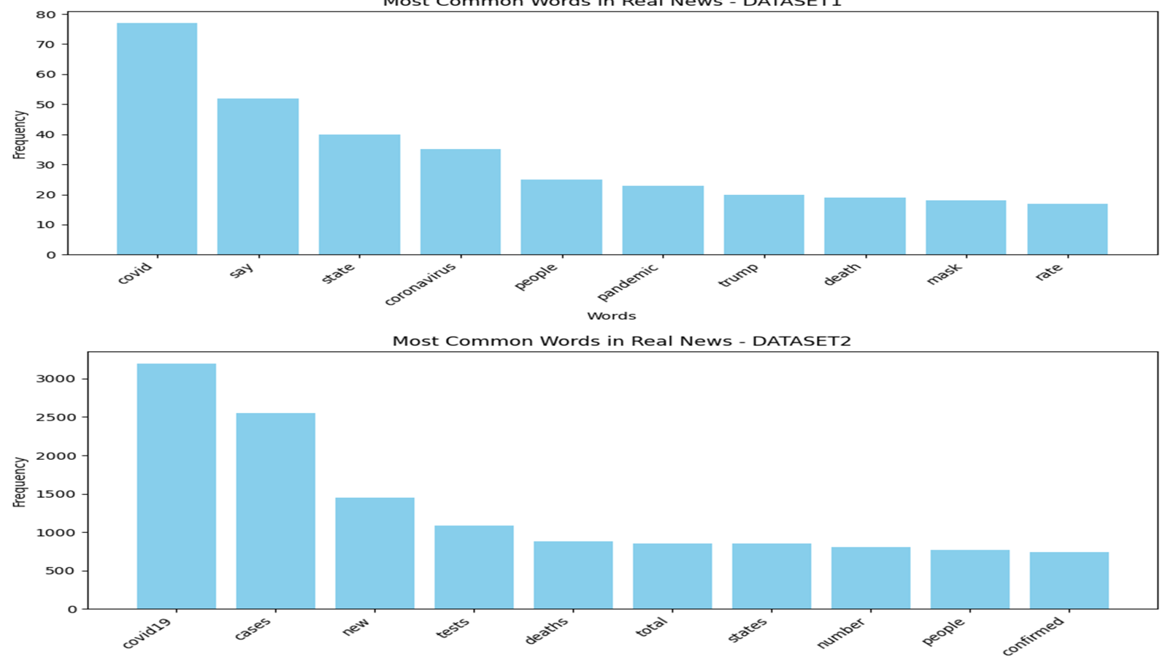
eda

Slide 25
Data Cleaning for CNN Models
Removing Stop Words: Reduces noise and focuses on important terms
“The quick brown fox jumps over the lazy dog” → “quick brown fox jumps lazy dog”
Lemmatization: Normalizes words to their base form
“The cats are running” → “cat run”

Slide 26
Why CNN Needs These Steps
Enhances feature extraction
Simplifies text data for convolutional layers
Remove noise

Slide 27
Data Cleaning for BERT Models
No Stop Words Removal: Contextual embeddings handle common words
No Lemmatization Needed: Subword tokenization manages word variations
Example: “The cats are running” → “The cats are running” (unchanged)

Slide 28
Why BERT Doesn’t Require Extensive Preprocessing
Handles context and variations internally
Built-in mechanisms for understanding word meaning

Slide 29
Effect on Performance
CNN: Better with preprocessed, normalized text
BERT: Benefits from raw text with rich contextual understanding

Slide 30
Vectorization Techniques
TF-IDF measures word importance in documents
Word2Vec: Vector representation based on word similarity.
End-to-End CNN Embeddings: CNN-based embeddings.
BERT Embeddings: Contextual embeddings from BERT.

Slide 31
tokenization
Tokenization: breaking down a text into smaller pieces called tokens, maybe words or subwords
As I love programming : [I, love, programming]
I love unhealthy food : [ I , love, un, healthy, food]

Slide 32
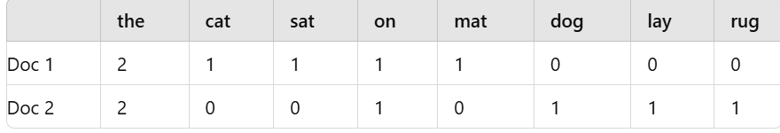
Bag of words
Bag of Words (BoW) is a simple and common text representation technique in natural language processing. It converts text data into a numerical format by counting the occurrence of each word within a document, ignoring grammar and word order but maintaining multiplicity.
Example:
Consider two sentences:
"The cat sat on the mat."
"The dog lay on the rug."

Slide 33
Tf-idf
TF-IDF is a statistical measure used to evaluate the importance of a word in a document relative to a collection of documents (corpus). It combines two metrics:
Term Frequency (TF): How often a word appears in a document.
Inverse Document Frequency (IDF): How unique or rare a word is across the corpus.
The TF-IDF value increases with the number of occurrences within a document but is offset by the frequency of the word in the entire corpus, helping to identify important words that are not too common.

Slide 34
Tf-idf
Example:
For the same two sentences:
"The cat sat on the mat."
"The dog lay on the rug."
Assume the corpus contains only these two documents.
TF for "cat" in Doc 1: 1/6 (1 occurrence out of 6 words)
IDF for "cat": log(2/1) = 0.301 (appears in 1 out of 2 documents)
TF-IDF for "cat" in Doc 1: 1/6 * 0.301 ≈ 0.050

Slide 35
word2vec
Word2Vec is a deep learning model used to produce word embeddings, which are vector representations of words capturing semantic relationships and similarity. It operates using two main algorithms: Continuous Bag of Words (CBOW) and Skip-gram. Word2Vec considers the context of words within a window to learn these representations.

Slide 36
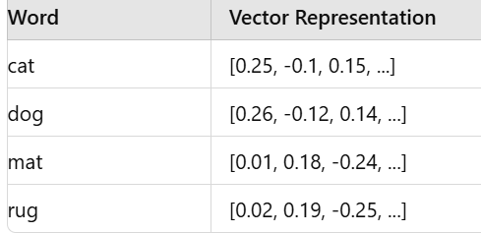
word2vec
Example:
For the sentences:
"The cat sat on the mat."
"The dog lay on the rug."
Word2Vec will create vectors for each word such that words with similar meanings (e.g., "cat" and "dog") are closer together in the vector space.

Slide 37
End to end embeddings
Similar to word2vec but it occurs during training not before it
Advantages: task specific
Disadvantages: take more training time

Slide 38
Bert embeddings
BERT (Bidirectional Encoder Representations from Transformers) embeddings are contextualized word embeddings generated using the BERT model. Unlike traditional embeddings such as Word2Vec, which produce a single embedding for each word regardless of its context, BERT embeddings capture the meaning of a word based on its surrounding context in a sentence. This is achieved through the transformer architecture, which considers both left and right context simultaneously.

Slide 39
Bert embeddings
Example:
Consider the word "bank" in two different sentences:
"He sat on the river bank."
"She went to the bank to deposit money."
Traditional embeddings would generate the same vector for "bank" in both sentences. However, BERT embeddings would produce different vectors for "bank" in each sentence, reflecting its different meanings.
For sentence 1: The embedding for "bank" might capture associations with "river" and "sat."
For sentence 2: The embedding for "bank" might capture associations with "deposit" and "money."

Slide 40
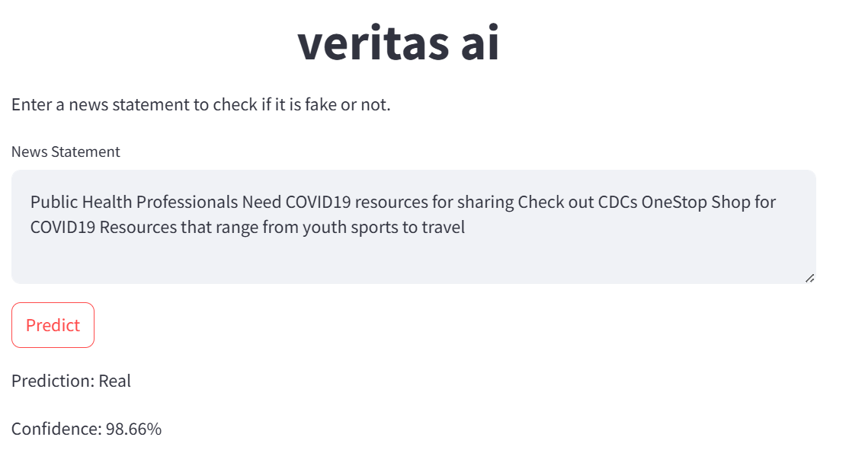

Slide 41
Modeling & evaluation
Develop and Train Models:
Different Machine Learning models
CNN (End-to-End Embeddings, Word2Vec) with accuracy of 91%
LSTM with accuracy close to 88%
BERT with accuracy 94%
RoBERTa with accuracy 95%
Fine-Tuning: Optimize model performance.

Slide 42
Evaluation metrics
Confusion matrix
Classification report

Slide 43
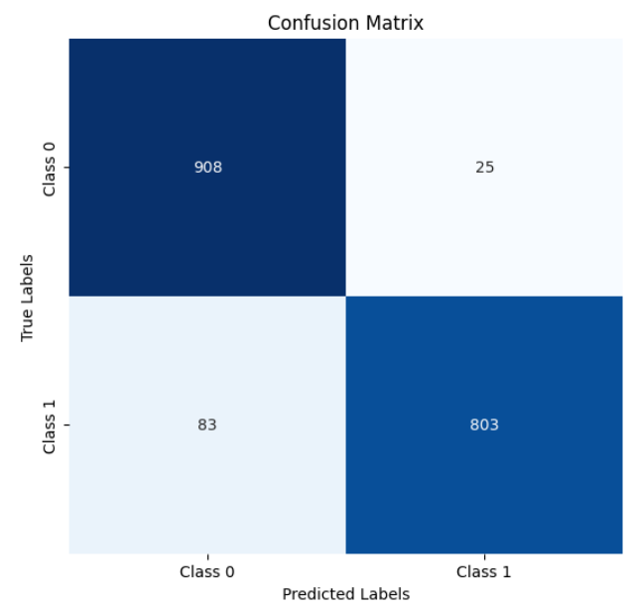
Confusion matrix

Slide 44
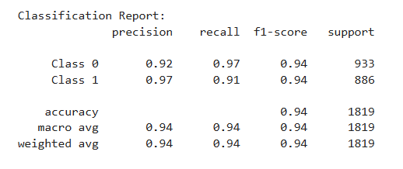
Classification report

Slide 45
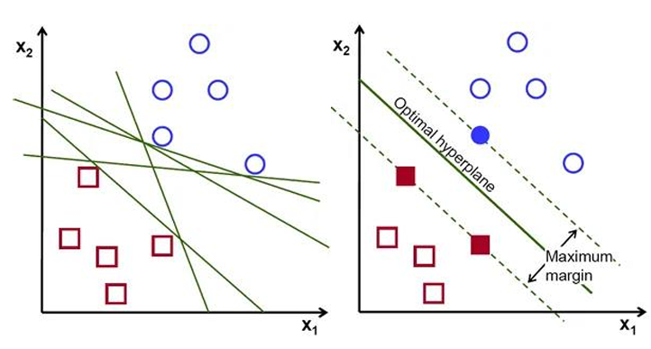
Support Vector Machine (SVM)
Description: A classification algorithm that finds the hyperplane separating different classes with the maximum margin. Useful for both linear and non-linear classification.

Slide 46
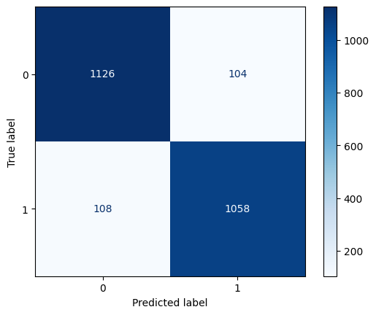
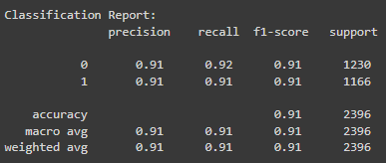

Slide 47
Cnn
Convolutional Layer
Filters/Kernels
Padding
Activation Function (e.g., ReLU)
Pooling Layer (e.g., Max Pooling, Average Pooling)
Fully Connected (Dense) Layer
Dropout
Batch Normalization
Backpropagation
Learning Rate
Loss Function
Optimizer (e.g., SGD, Adam)
Epochs
Training, Validation, and Testing Data

Slide 48
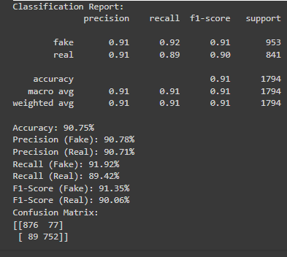
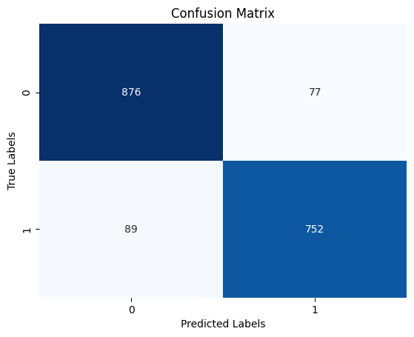
CNN end to end Embeding

Slide 49
rnn
Hidden State
Recurrent Connections
Sequence Processing

Slide 50
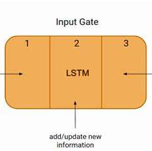
lstm
Forget
Forget Gate
Input
Input Gate
Output
Output Gate

Slide 51

Vanishing gradient
The vanishing gradient problem is a common issue encountered during the training of deep neural networks, particularly in recurrent neural networks (RNNs) and deep feedforward networks. This problem occurs when the gradients of the loss function with respect to the weights become very small, approaching zero, as they are propagated backward through the network during the process of backpropagation.

Slide 52
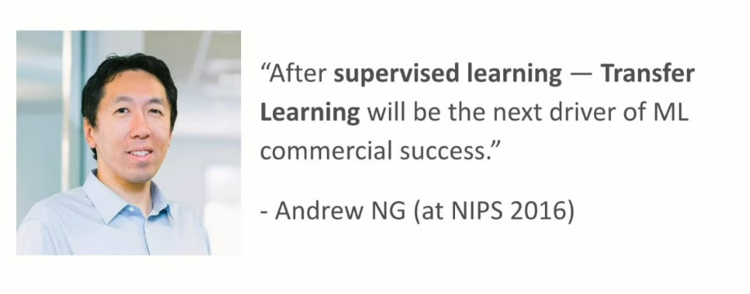
Transfer learning

Slide 53
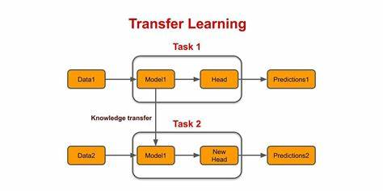
Transfer learning

Slide 54
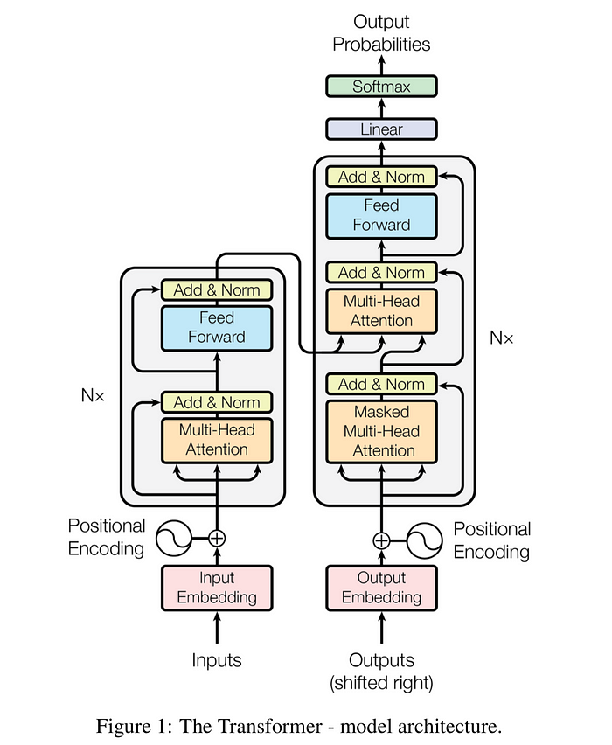
Tranformers
Transformers are a type of deep learning model introduced in the paper "Attention Is All You Need" by Vaswani et al. in 2017. Transformers have revolutionized natural language processing (NLP) and various other tasks due to their ability to handle long-range dependencies and parallelize training efficiently.

Slide 55
Attention is all you need
The attention mechanism allows the model to weigh the importance of different tokens in the input sequence dynamically, enabling it to capture long-range dependencies more effectively than traditional RNNs or CNNs. This mechanism is central to the transformer architecture introduced in the "Attention Is All You Need" paper, facilitating efficient parallelization and improved performance on various sequence-to-sequence tasks.

Slide 56
Bert
How bert is pretrainedtrained
MLM masked language modeling
NSP next sentence predicting

Slide 57
Bert architecture
Self-Attention Mechanism
Multi-Head Attention
Feedforward Neural Network
Token Embeddings
Segment Embeddings
Position Embeddings
Bidirectionality
Residual Connections
CLS Token
SEP Token

Slide 58
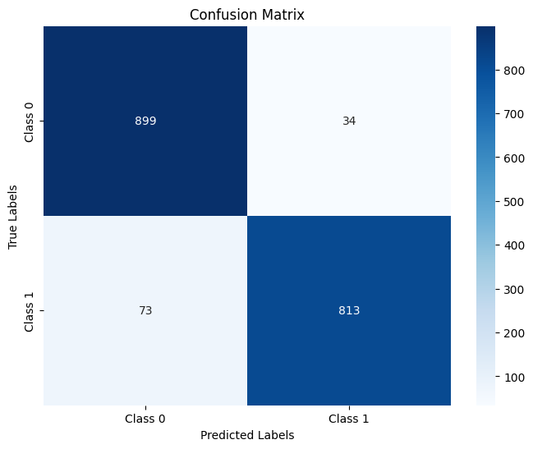
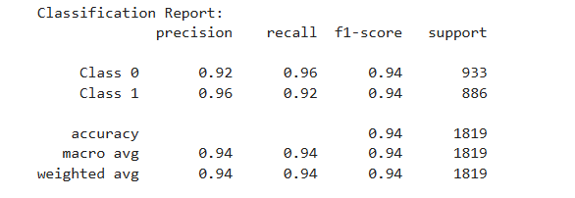
Bert

Slide 59

Roberta
Just like bert but more robust as it is trained on more data

Slide 60
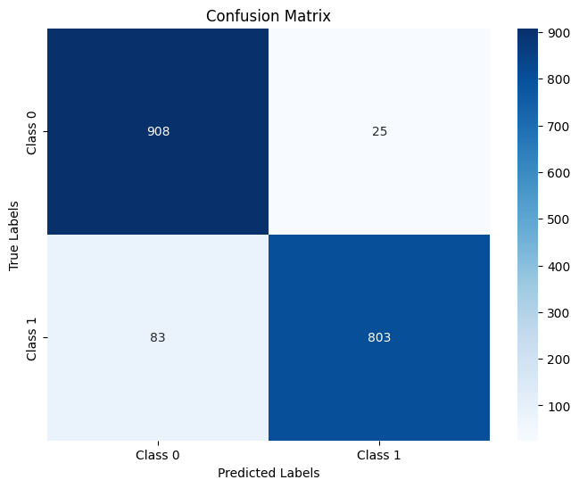
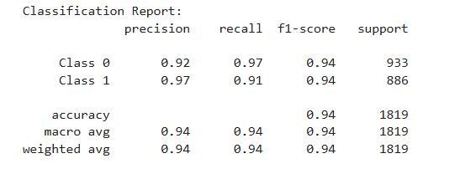
Top model

Slide 61

Deployment
Why streamlit?
It is made specifically for data scientists to deploy their models
Easier to deploy than Django or flask

Slide 62
Further work
Fake bert
Knowbert

Slide 63

Special thanks to dr Mohamed awni

Slide 64

Thank you

